Slide 1
ROLES OF NETWORKS IN DEVELOPING COUNTRIES
Presenter: BARUGAHARE BANSON

Slide 2

INTRODUCTION
A network connects computers and devices.
A network enables communication and information sharing.
Networks plays a major role in social and economic growth.

Slide 3
TYPES OF NETWORKS
Network Type | Meaning | Example
PAN | Personal Area Network | Bluetooth,hotspot
LAN | Local Area Network | School or Office website
MAN | Metropolitan Area Network | City Network
WAN | Wide Area Network | Internet ,Cross-country links

Slide 4
Why Networking Matters in Developing Countries
Reduces communication barriers
Improves access to education and healthcare
Supports government efficiency
Enables digital economy and innovation

Slide 5
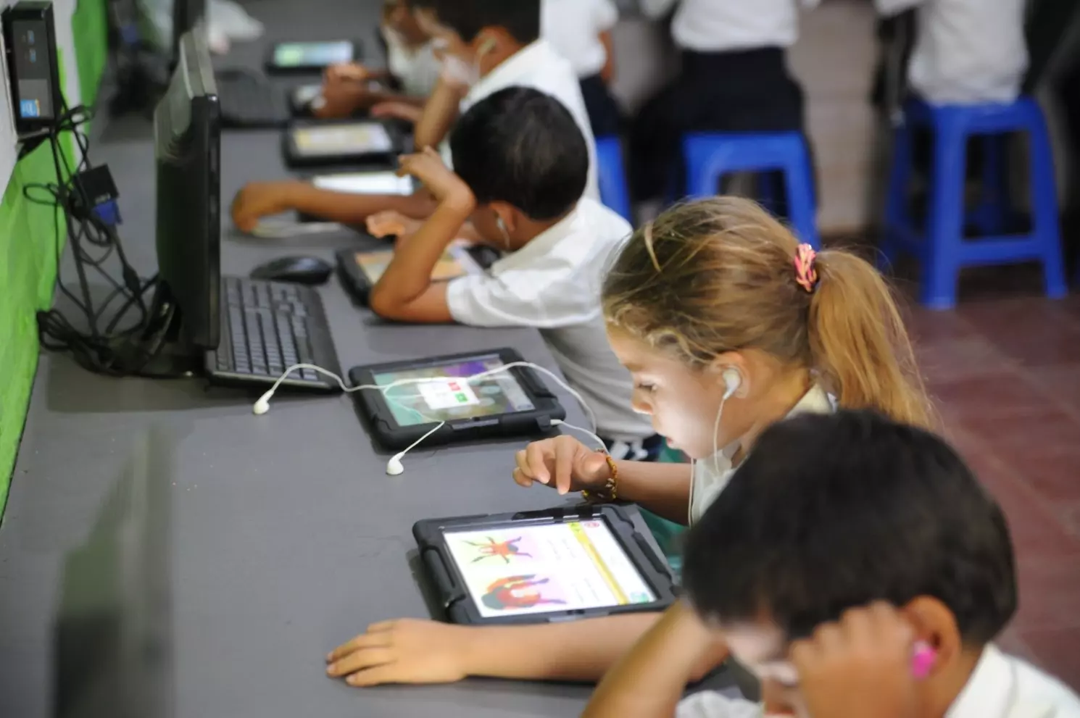
Roles of Network in Education
Facilitates online learning platforms ( e-learning)
Helps in virtual classrooms and video conferencing
Allows access to digital libraries and global research

Slide 6
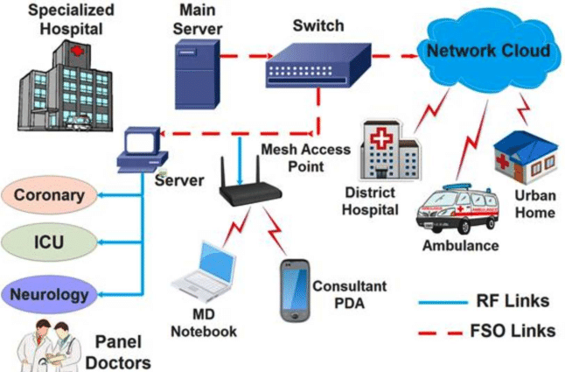

Roles of Network in Healthcare
Provides telemedicine services
Helps in patient record sharing
Fastens emergency communication

Slide 7


Roles of Network in Business and Economy
Helps in e-commerce and mobile banking
Facilitates cloud services for start up
It helps in job creation through remote work and outsourcing

Slide 8

Roles of Network in Governance
E-Government services
Digital public records
Improved communication with citizens
Digital public infrastructure

Slide 9
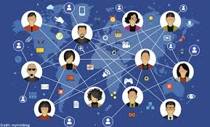
Roles of Network in Social Development
Helps in accessing platforms for awareness campaigns
Bridging rural-urban communication gaps
Provides social media and communication tools

Slide 10
Challenges
High internet costs
Poor infrastructure
Lack of digital skills
Political restrictions

Slide 11
Solutions and Strategies
Government investment
Public–private partnerships
Digital skills training
Affordable internet initiatives

Slide 12
Conclusion
Networks are a foundation for digital transformation.
They improve education, healthcare, economy, and governance.
Developing countries must continue investing in network infrastructure for inclusive growth.

